Slide 2
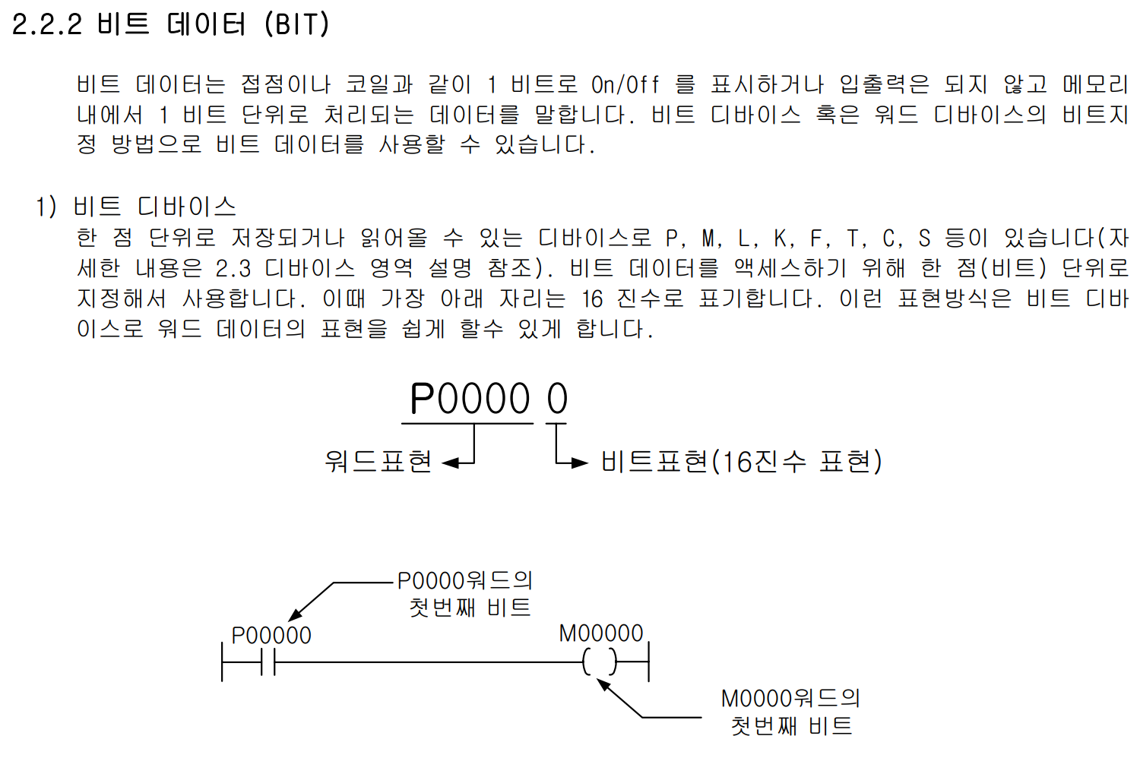
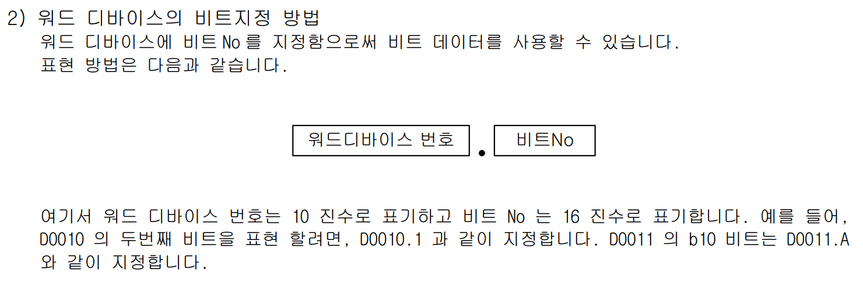

Slide 3
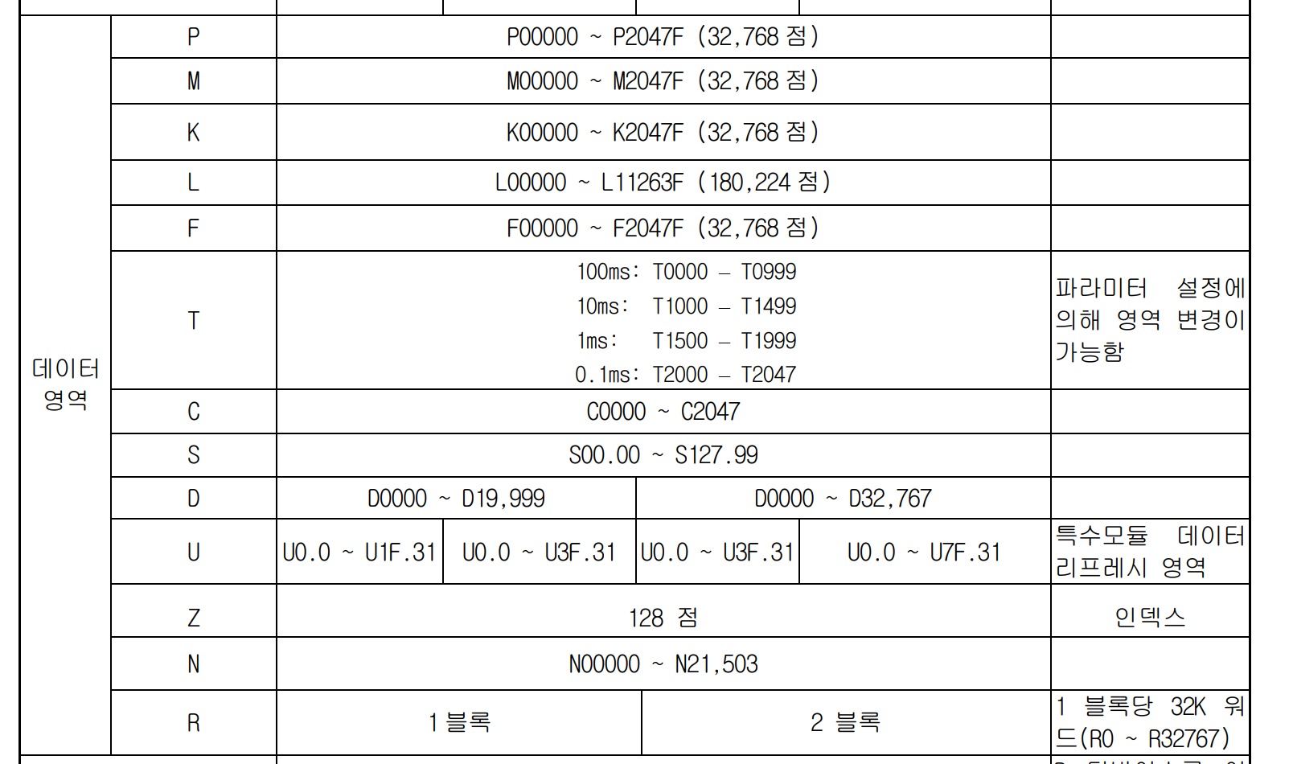

Slide 4
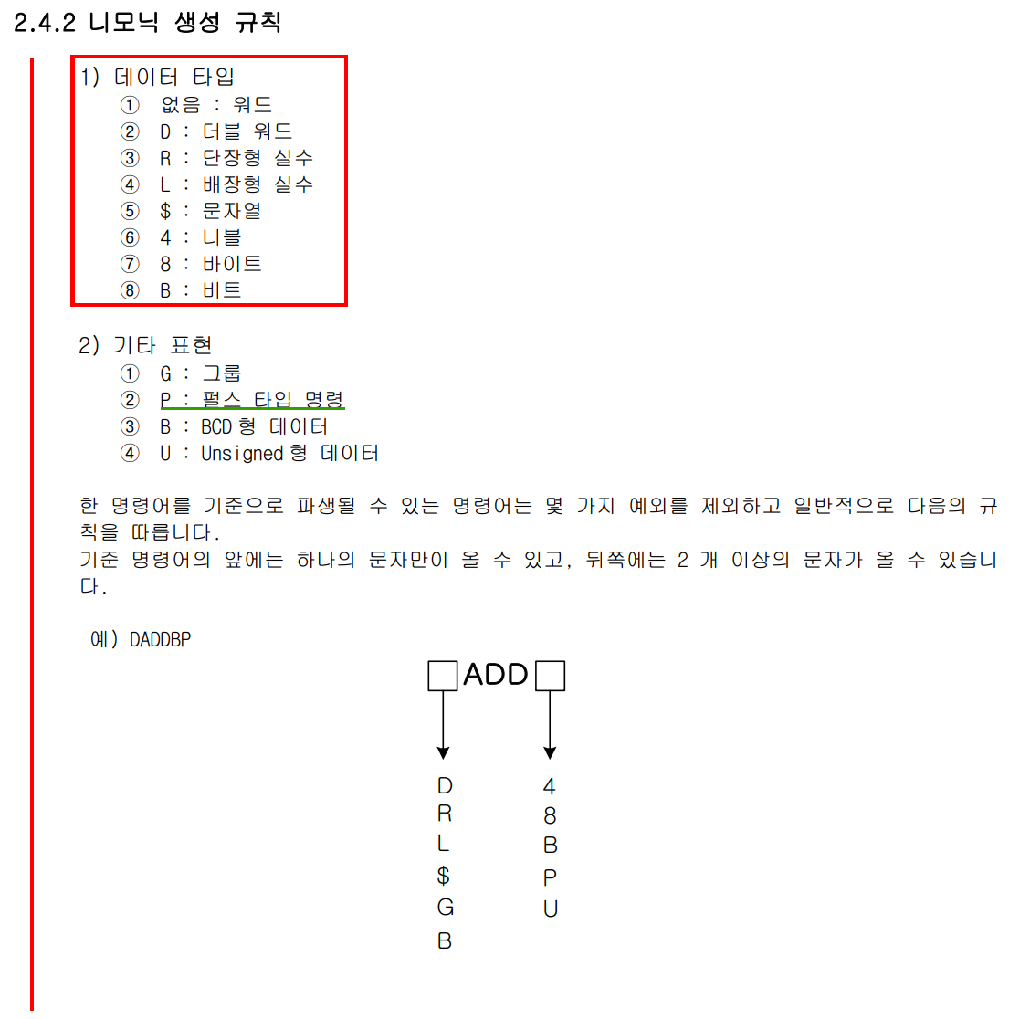

Slide 5
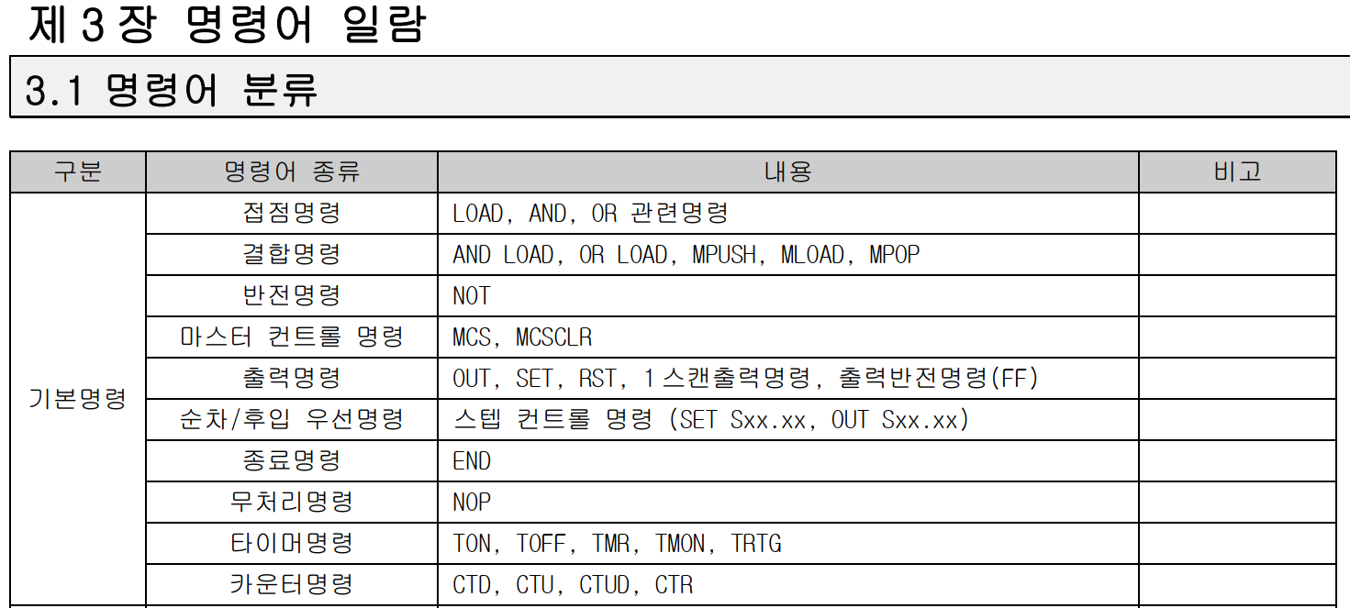
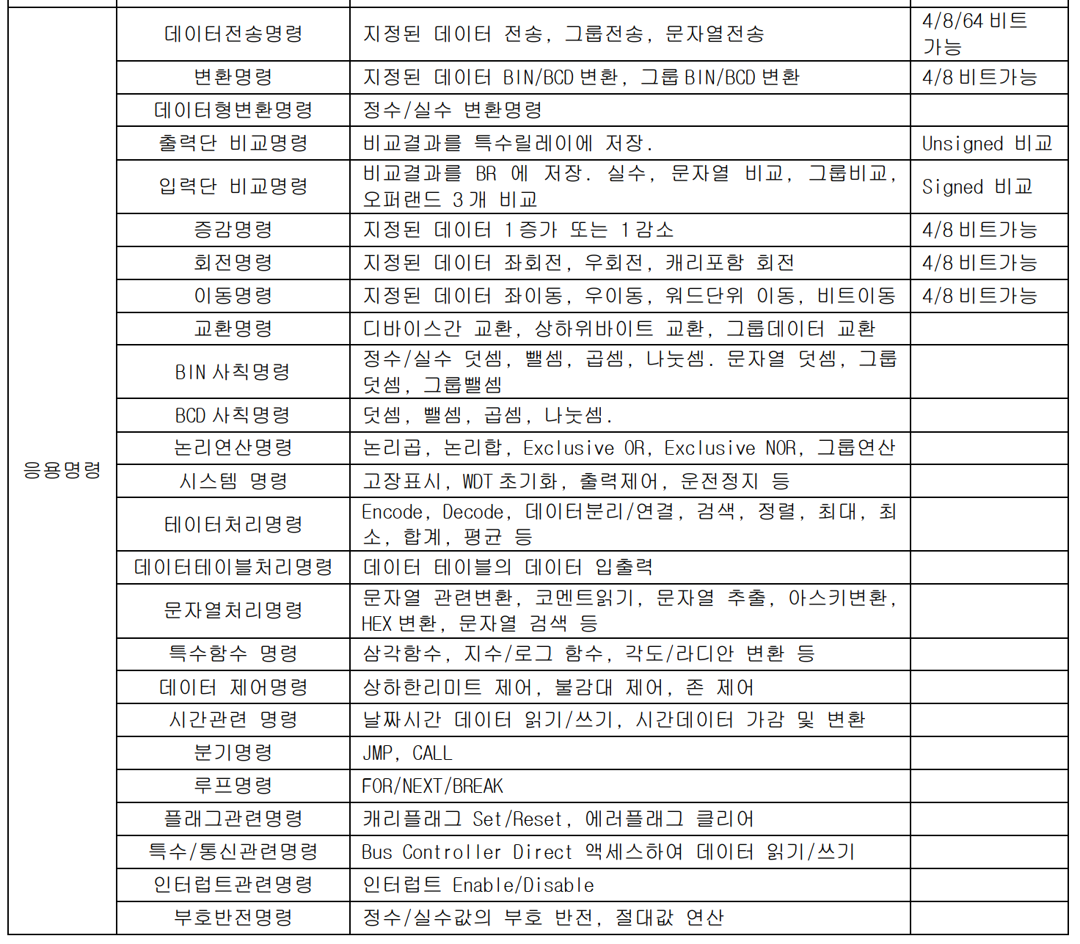

Slide 6
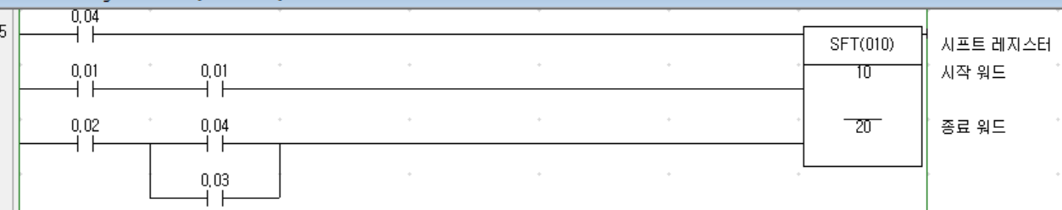
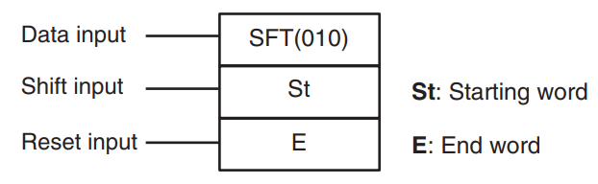
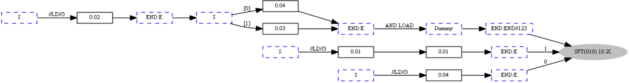
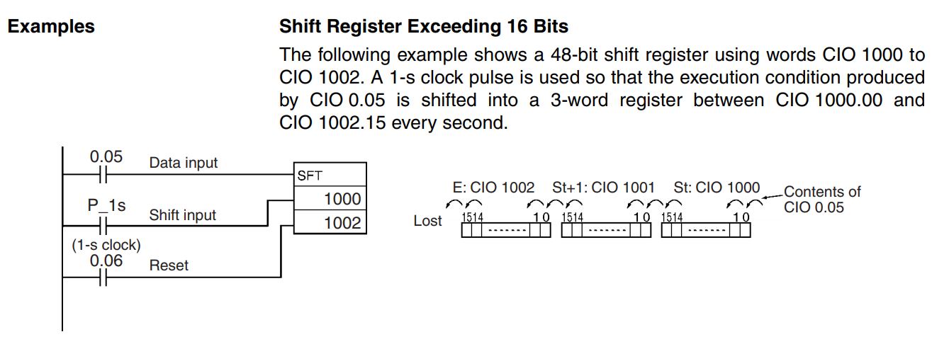
SFT
Data input 조건이 충족하면 Shift input 충족할 때, data shift 수행
Reset input 켜지면 St ~ E 까지 메모리 clear
When the execution condition on the shift input changes from OFF to ON, all the data from St to E is shifted to the left by one bit (from the rightmost bit to the leftmost bit), and the ON/OFF status of the data input is placed in the rightmost bit.
The bit data shifted out of the shift register is discarded.
When the reset input turns ON, all bits in the shift register from the rightmost
designated word (St) to the leftmost designated word (E) will be reset (i.e., set
to 0). The reset input takes priority over other inputs.
St must be less than or equal to E, but even when St is set to greater than E
an error will not occur and one word of data in St will be shifted.
When St and E are designated indirectly using index registers and the actual
addresses in I/O memory are not within memory areas for data, an error will
occur and the Error Flag will turn ON.

Slide 7
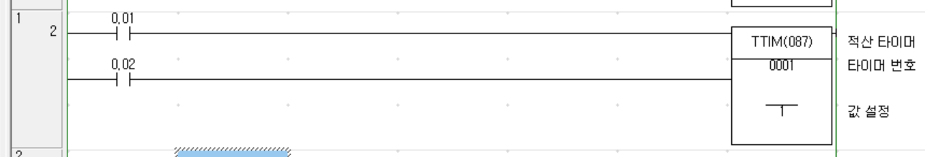
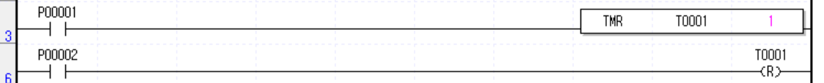
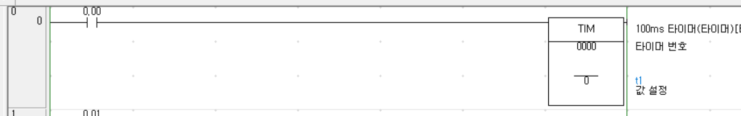
TMR
LD 0.01
LD 0.02
TTIM(087) 0001 1
LOAD P00001
TMR T1 1
LOAD P00002
RST T0001
LD 0.00
TIM 0000 0
LOAD P00000
TON T0 0

Slide 8
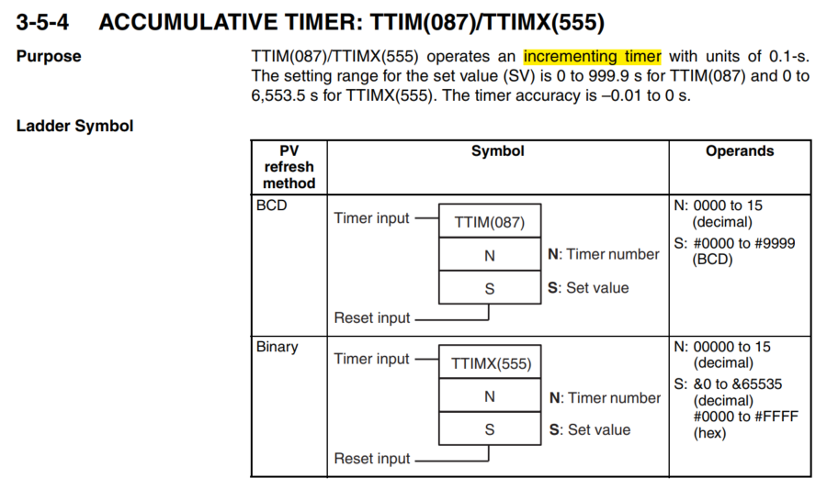

Slide 9
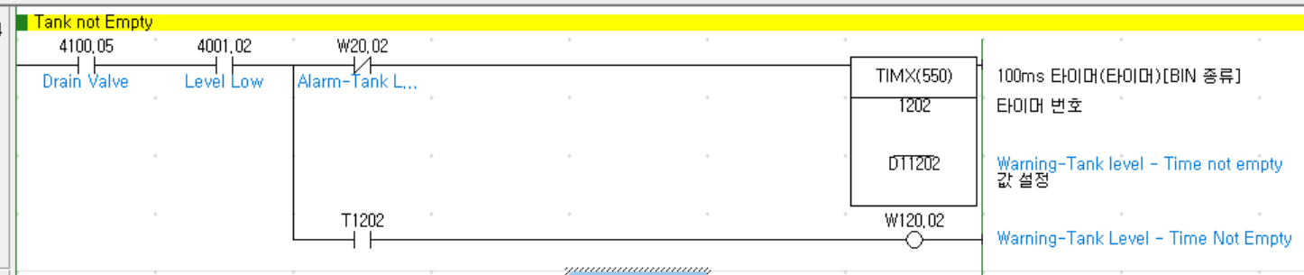
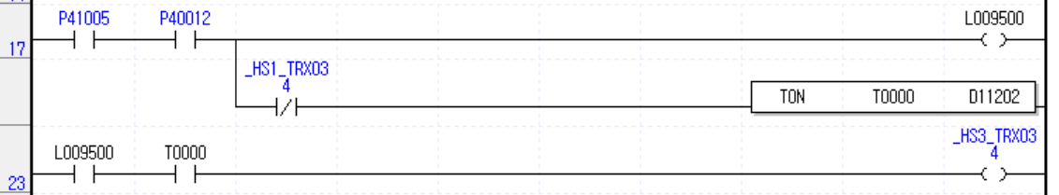
TIMX – 기존 변환기 결과

Slide 10
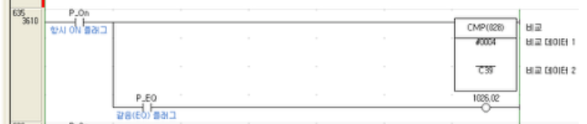
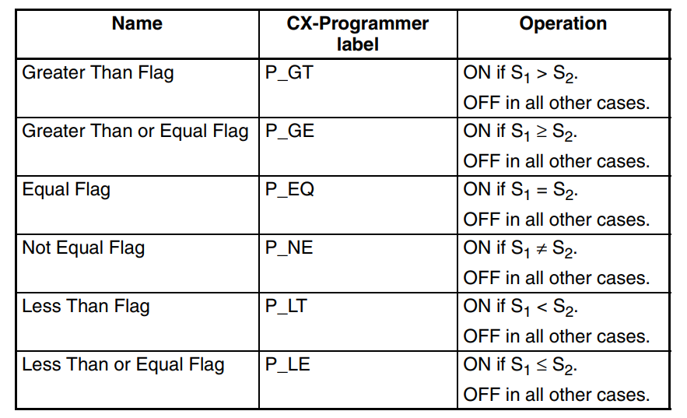
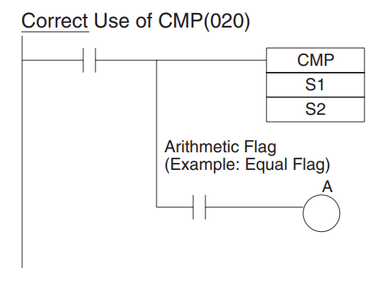
비교(CMP)

Slide 11
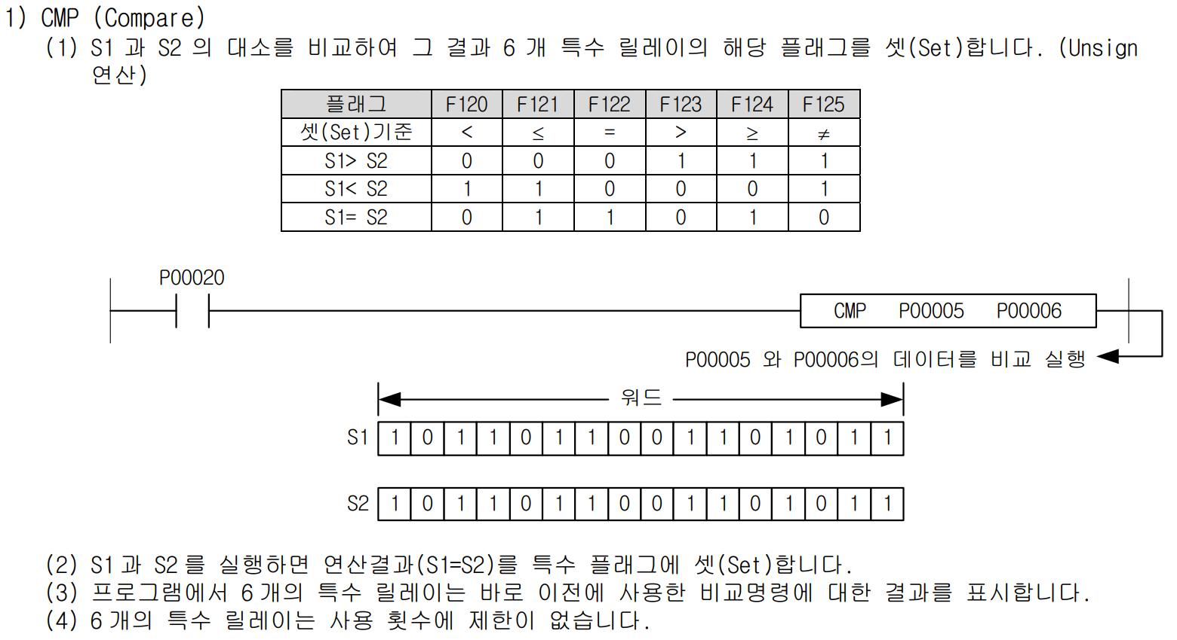
산전 : 비교(CMP)
Notes:
pp217. 사용설명서_XGK_XGB_명령어집_국문_V2.3.pdf

Slide 12
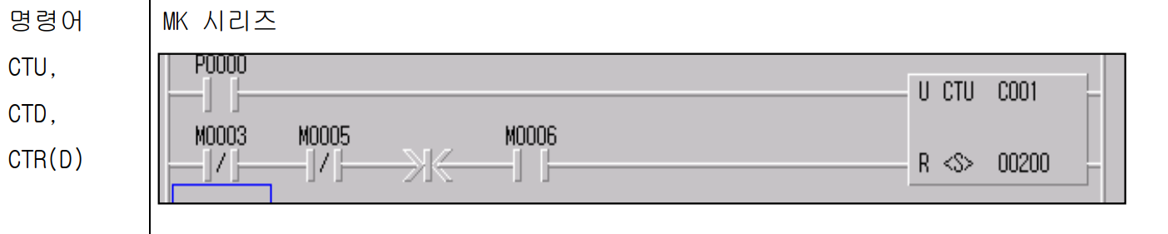

Slide 13
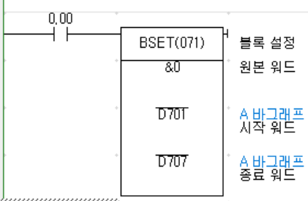
BSET

Slide 14
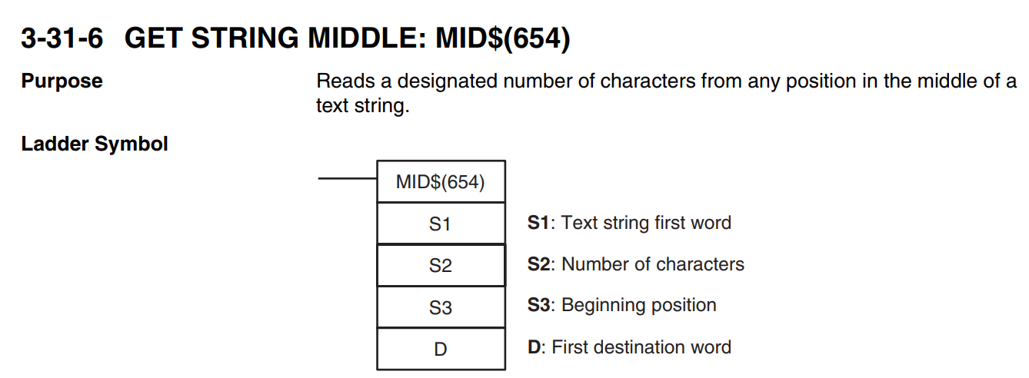
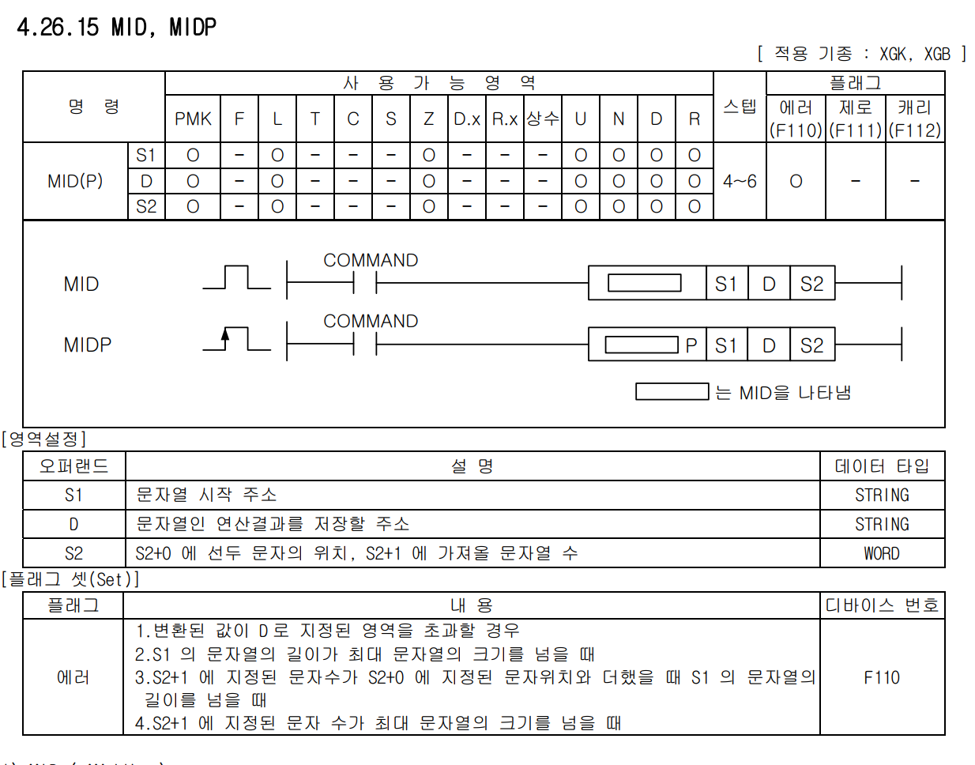
MID$ : 변환 불가. S2 가 간접지정
임시 버퍼에 산전의 S2 에 해당하는 값을
쓸 수도 있으나… 좀 번거로움.

